Slide 2
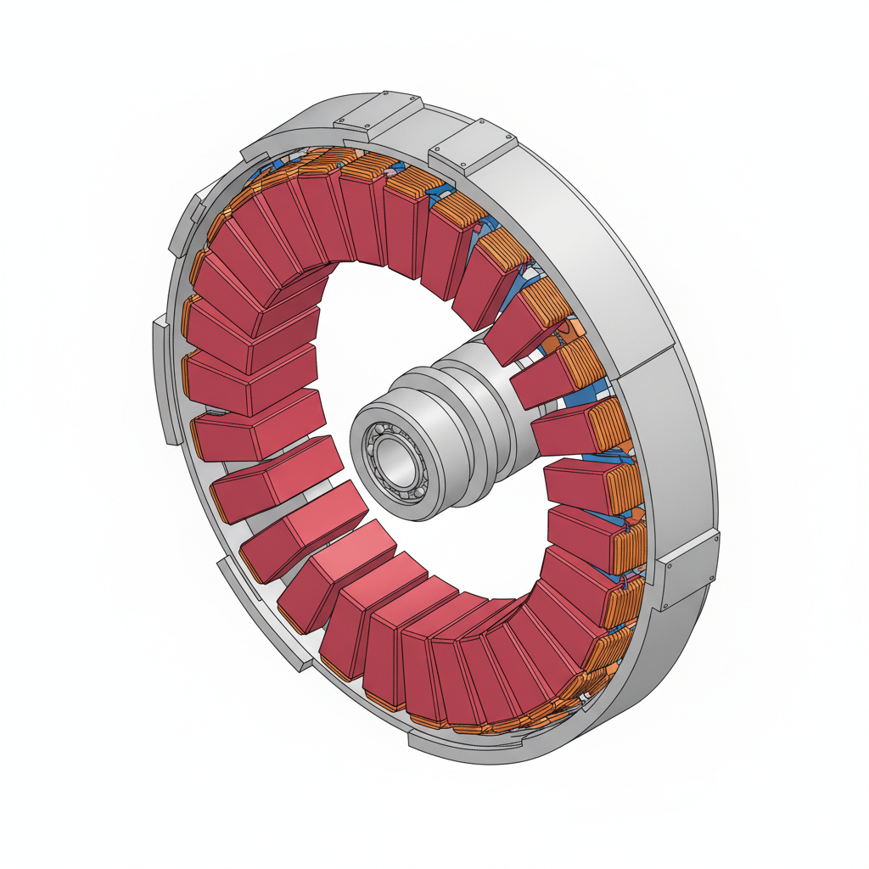
Generator Housing (Stator Frame)
Neodymium Permanent Magnets (Rotor)
Central Shaft & Bearing System
Copper Stator Windings

